Slide 1
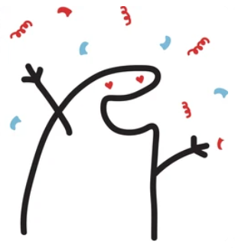
Inner Reform & Brain-change
How neuroscience and psychology reinforce the spiritual concept of "inner transformation."
Spiritist Society Towards the Light – March/April 2026

Slide 2

Tonight’s Roadmap & Purpose of the Lecture - Spiritism “inner reform” progressively explained by science - ways of moral transformation, connection with brain works & energy
Part 1 – March 18, 2026
  The brain learns through wiring: neurons, connections, and habits
  ' Use it or lose it': how pathways strengthen and weaken
Part 2 – March 18, 2026
  Manual change: relabel, refocus, and repetition
  Therapy & meditation: making the unconscious conscious
Part 3 – April 1, 2026
  Biological Mechanisms & Moral Transformation
  Will, resilience, intellectual and moral progress
Daily Practice – Conclusion - Discussion Practices - References
Notes:
Block A (Slides 2–5, 7–8): Understanding habits & how the brain learns

Slide 3

The Brain and Moral Habits
Part 1
Why is it so hard to identify what isn’t working—and then change it?
Ignorance of moral habits and its consequences - self-centrism.
How brain pathways shape habits and reactions
The brain learns through wiring: neurons, connections, repetition, and habit formation
Automatic Neural Pattern Reactions vs Conscious Moral (Spirit) Choice
Use It or Lose It
  Repeated use strengthens pathways; disuse weakens them
Notes:
Block A (Slides 2–5, 7–8): Understanding habits & how the brain learns

Slide 4
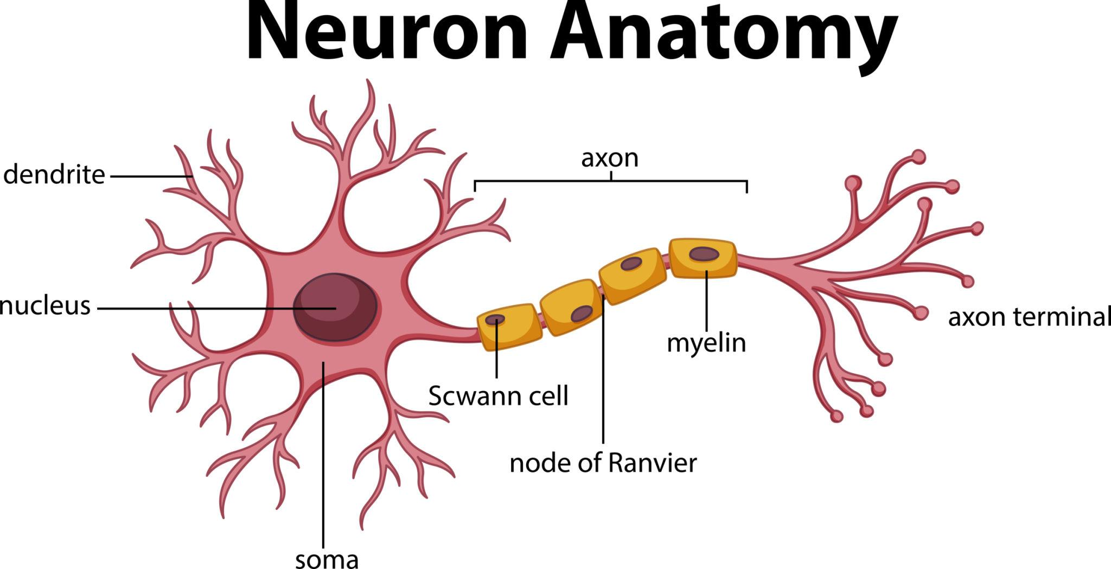
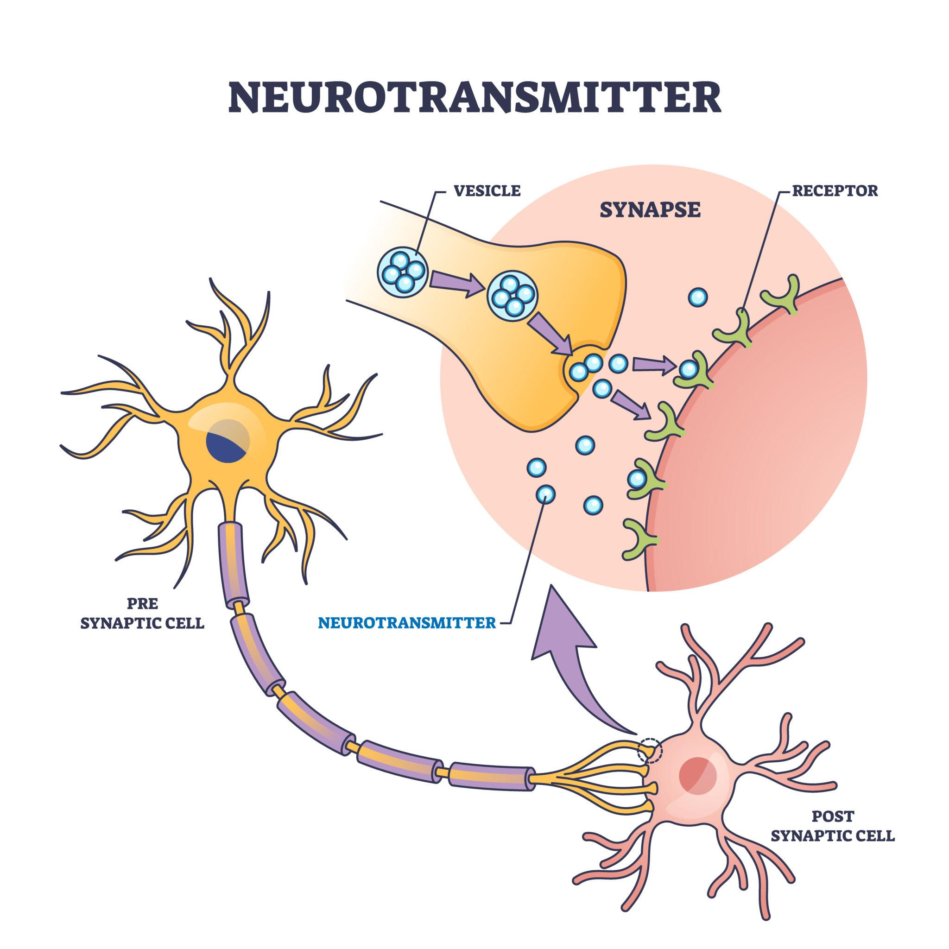
The Core Difficulty
Part 1
Many inner reactions feel like 'me'… but they are often trained pathways.
Automatic patterns run fast, before reflection has time to act – caused by moral standards & traumas.
Inner reform” begins by seeing: “this is a pattern, not my essence.”
Notes:
Block A (Slides 2–5, 7–8): Understanding habits & how the brain learns

Slide 5
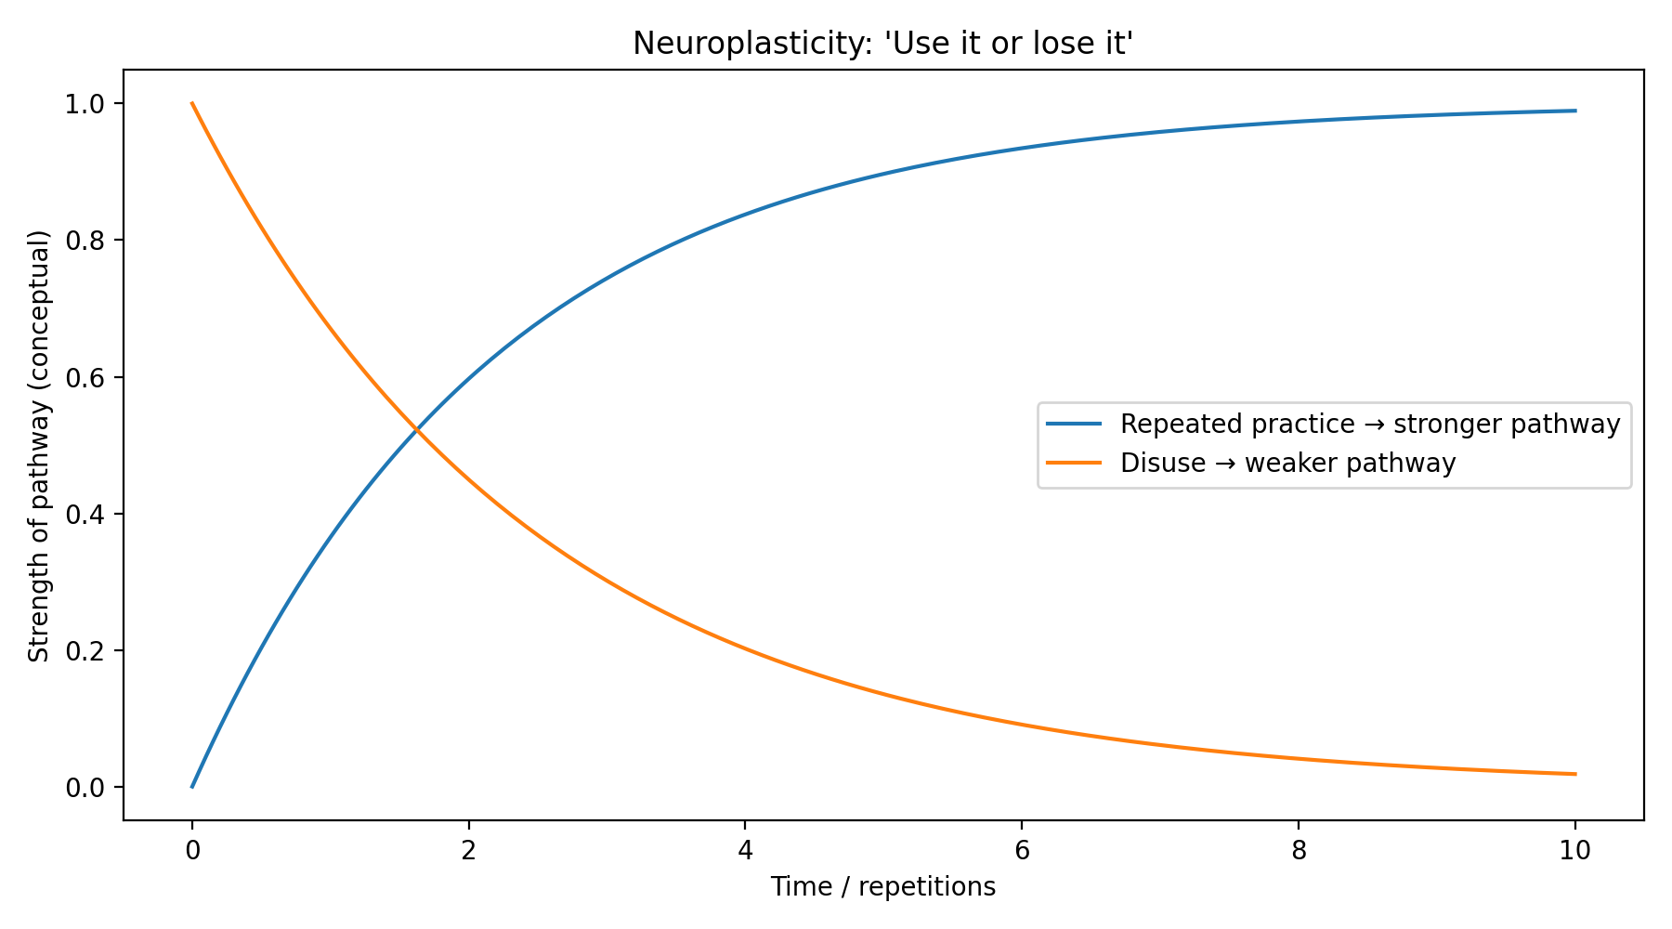
'Use it or lose it’: pathways strengthen and weaken based on our “conscious choices”.
Part 1
Notes:
Block A (Slides 2–5, 7–8): Understanding habits & how the brain learns

Slide 6

“Neurons that fire together wire together”
Part 2
Why Spiritism recommends observation or “vigilance” over our thoughts?
When a thought + emotion + action repeats, the brain strengthens that pathway.
Over time, the response becomes automatic (habitual).
Notes:
Block A (Slides 2–5, 7–8): Understanding habits & how the brain learns

Slide 7
“Neurons that fire together wire together”
Part 2
Limited moral standards of the conscious self (spirit) contribute to egoistic approach to life, leading to why repeated “negative and selfish behaviour” can become 'the default.'
Notes:
Block A (Slides 2–5, 7–8): Understanding habits & how the brain learns

Slide 8
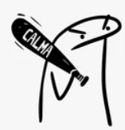
Changing Inner (moral) Patterns & Rewiring the Mind
Part 2
relabel, refocus, and repetition
Spiritist View: We train the will to guide the mind, not be dragged by impulse or instinct.
Brain-change method for transforming moral mental habits.
What we’re aiming for: reduce fuel to the "old circuit", and build a new one with repetition.
Key idea:
attention strengthens what it repeatedly touches.
Notes:
Block A (Slides 2–5, 7–8): Understanding habits & how the brain learns

Slide 9

Part 2
Changing Inner (moral) Patterns & Rewiring the Mind
Step 1: Relabel (create distance)
Instead of: “I am anxious / I am angry”
Try: “This is an anxious thought” or “This is an angry impulse.”
Why it helps: it creates space for observation, reducing identification with the reaction.
Spirit guiding the mind:
the observer-self (conscience) watches the
lower-self without merging with instinct or impulse.
Notes:
Block B (Slides 9–13): Practical steps to change inner patterns

Slide 10

Part 2
Changing Inner (moral) Patterns & Rewiring the Mind
Step 2: Refocus (response prevention)
As soon as you notice the old loop, gently redirect attention to a wholesome action.
Examples: elevate your thoughts, connect with “the positive”. All is energy…prayer, breathing, service, a task, a calming walk, recurrence of constructive conversations.
Why this helps:
attention is the 'nutrition' of pathways (energy)—what you feed grows stronger.
Notes:
Block B (Slides 9–13): Practical steps to change inner patterns

Slide 11

Imagination and Thinking Leave Physical Traces – ALL IS ENERGY Inside and Outside the Body & Mind
Part 2
Mental practice activates many of the same brain pathways as physical practice.
Repeated visualization can strengthen new responses (e.g., be under stress or cure from stress).
Bridge idea: the immaterial mind influences material brain structure through repetition and energy/chemical transformation of DNA.
Faith/thoughts are the spiritual, moral conscious power to channel energy internally through the body structures to promote change.
Faith might also be the spiritual, moral conscious power to channel energy externally to the body to promote change.
Notes:
Block B (Slides 9–13): Practical steps to change inner patterns

Slide 12

Common Thinking Traps (Cognitive Distortions)
Part 2
Common thinking traps and moral imperfections
Catastrophizing: 'This will end badly.'
Mind-reading: 'They must think I’m terrible.'
All-or-nothing: 'If I fail once, I’m a failure.’
“Inner Reform”, names the distortion, then chooses a truer interpretation.
Notes:
Block B (Slides 9–13): Practical steps to change inner patterns

Slide 13

Meditation is a tool to implemente Spiritsms “vigilance” or self‑examination of thoughts
Part 2
Meditation as neuroplastic training.
By being “vigilant of our thoughts,” we are making the unconscious patterns conscious (i.e. our acting self based moral).
Gives the space to observe the “self” and realize that it may not reflect the real person we are.
Opportunity to reflect on our “moral” that underpins thoughts and actions…chance to access our real self…train “the will”…that mobilizes and emanates energy internally (impact at cell/DNA level) and externally.
Observed reflection of our moral approach to life, allows us to change our will/thoughts/words/action materializing in our mind & body our “inner reform”.
Notes:
Block B (Slides 9–13): Practical steps to change inner patterns

Slide 14
Conclusion – “Inner Reform” as a Conscious Practice of Transformation
Inner reform is not abstract - It is a trainable, repeatable process supported by neuroscience and affirmed by Spiritist teachings.
Faith & Will as Transformative Forces
Internally: shaping neural pathways, emotions, and biological expression
Externally: influencing our energetic presence and relationships
What We Are Actually Changing - Many reactions come from conditioned neural patterns, not our true spiritual identity. Awareness separates the spirit (conscient will) from the habit (automatic mind).
True Change Requires
Persistence over insight
Practice over intention
Compassion over judgment
Neuroplasticity Confirms the Path
Repeated attention + intention + action = rewiring of the brain and behavior
Meditation & Vigilance of Thought
Make the unconscious conscious
Interrupt automatic reactions
Strengthen the “will” aligned with higher moral values
Spiritist formula: Relabel → Refocus → Repeat → Elevate
2
Notes:
Block B (Slides 9–13): Practical steps to change inner patterns

Slide 15

“Will”, resilience, intellectual and moral awareness: The Basis for “inner reform”
Part 3
Science progressively aligns with Spiritism to explain how “inner reform” operates — ”will” and resilience transform
Short‑Term to Long‑Term Memory - Proteins and synaptic strengthening create lasting learning.
Genes and Lasting Learning - Experience influences gene expression in neurons.
Implicit vs Explicit Memory – Habits, instincts, impulses vs conscious recollection.
Sleep and Learning- Sleep consolidates emotional and cognitive learning
“Will” and Discipline - Persistence transforms habits and moral tendencies
Transforming Ghosts into Ancestors - Integrating unconscious patterns into wisdom.
Notes:
Block C (Slides 14–19): Will, memory & moral transformation

Slide 16

Why "Will" Matters?
Part 3
Change is rarely one insight—it is many repetitions.
“Will" is the bridge from self awareness → understanding → knowing → feeling → thinking → doing → self reinforcing the original “will”.
Spiritist View: moral progress needs persistence, vigilance (self-awareness), consciousness of why we feel and what we think when exercising our “will” by making our daily decisions.
Notes:
Block C (Slides 14–19): Will, memory & moral transformation

Slide 17

How “Will” Work?
Part 3
Learning is not only psychological—it is biological.
When learning becomes long-term, neurons grow or strengthen connections.
Deep insight or self-awareness +
repeated new behavior brought by “will” =
lasting neural change / “inner reform”.
Notes:
Block C (Slides 14–19): Will, memory & moral transformation

Slide 18

From Short-Term to Long-Term Memory (simple story)
Part 3
For short-term memory to become long-term, the brain must build new proteins.
Those proteins help strengthen connections and can grow new connections.
In plain terms: sustained practice is what makes change physically 'stick.’
Sustained practice can be based on the “will” to constantly pursue “inner reform”.
Notes:
Block C (Slides 14–19): Will, memory & moral transformation

Slide 19

A Simple Experiment: Learning Through Repetition
Part 3
Repeated pairing of a stimulus with harm can create a reflex (fear/defense).
Repeated exposure without harm can weaken that reflex (extinction).
Lesson: repetition trains the nervous system—both for wounds and for healing.
Our human spirit-conscious free“will” to commit to “inner reform” allows us to distance ourselves from the stimulus exposure that triggers the instinctive and impulsive chain reaction/action.
Notes:
Block C (Slides 14–19): Will, memory & moral transformation

Slide 20

Genes Have a “Transcript” Function (accessible view)
Part 3
Your DNA stays the same, but experience influences which genes are 'turned on' in our cells.
Turning on genes leads to new proteins that support learning and memory.
Practical material, mental, spiritual meaning: through energy (electrical impulses), what we repeatedly think and do can shape the brain’s wiring. That same energy outside the body manifests as “magnetism”.
“Faith”, “will” can really modify ourcells and our environment. The fuel, the engine, and the drive for “inner reform”.
Notes:
Block C (Slides 14–19): Will, memory & moral transformation

Slide 21
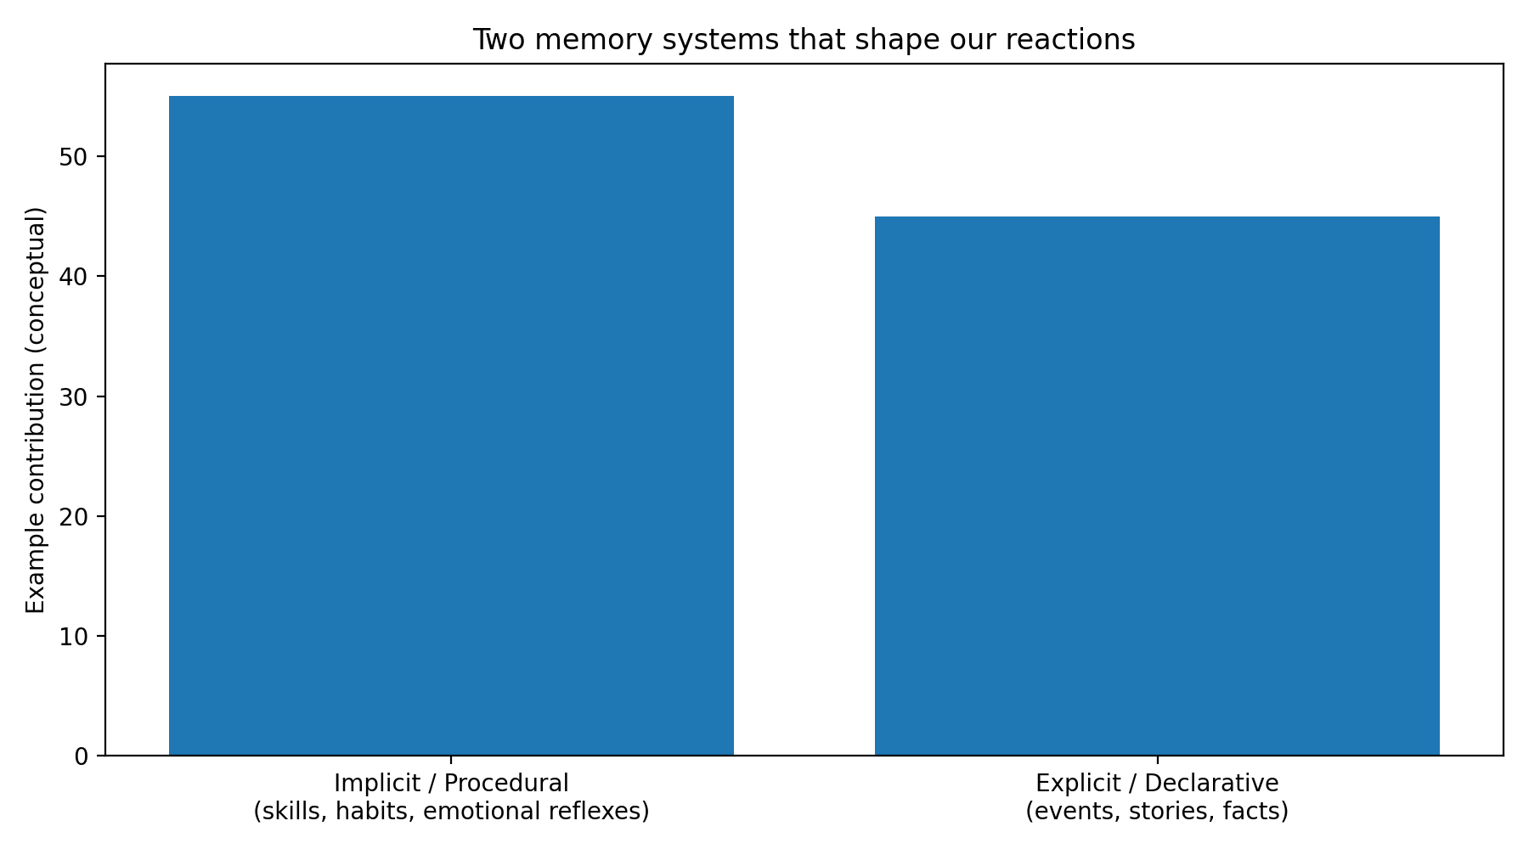
Two Memory Systems That Shape Us
Part 3
Notes:
Block D (Slides 20–28): Integration + daily practice + closing & prompts

Slide 22

Implicit vs Explicit: Why We React 'Out of Nowhere'
Part 3
Implicit (procedural) memory: habits, emotional reflexes—often outside awareness.
Explicit (declarative) memory: stories, events, facts—available to language.
Meditation & deliberated commitment to moral (spiritual) progress help bring automatic patterns into awareness, where choice is possible to be exercised by “will”. Transforming us internally.
Notes:
Block D (Slides 20–28): Integration + daily practice + closing & prompts

Slide 23

When We Remember, Memory Becomes Flexible
Part 3
Recalling a memory can briefly 'open' it for updating before it is stored again.
With safety, understanding, and new meaning, the emotional charge can change.
Spiritism parallel:
revisiting the past with the new lenses of self-awareness and its elevated moral, rewrites the inner response, transforming ourselves.
Notes:
Block D (Slides 20–28): Integration + daily practice + closing & prompts

Slide 24

Sleep: The Brain’s Consolidation Workshop
Part 3
Sleep supports the brain ‘saving’ what you learned—turning learning into stable long-term patterns.
Emotional material may appear in dreams when inhibition is reduced.
Practical takeaway:
"inner reform" needs rest;
exhaustion makes old pathways win.
Notes:
Block D (Slides 20–28): Integration + daily practice + closing & prompts

Slide 25

The Double-Edged Sword of Plasticity
Part 3
Brain-changeity builds skills… and it can also build rigidity.
Unvaried repetition (habits, grudges, fear loops) becomes efficient and automatic.
So “inner reform" requires deliberate interruption + deliberate repetition of the new conscious “will”.
Notes:
Block D (Slides 20–28): Integration + daily practice + closing & prompts

Slide 26

Transforming “Ghosts” into Ancestors
Part 3
A 'ghost' is an automatic pattern that appears suddenly and controls behavior that allows instincts and impulses to hijack our conscious “will” when feeling, thinking and making decisions in life.
An 'ancestor' is the same material integrated into a coherent story and meaning that aligns with our “will to inner reform”.
Integration reduces fear and increases freedom: what was unconscious becomes educative.
Notes:
Block D (Slides 20–28): Integration + daily practice + closing & prompts

Slide 27

Closing Message
Part 3
Neuroscience: repeated attention rewires the brain.
Psychology: awareness turns reaction into choice.
Spiritist View: meaning strengthens a positive "will".
Rewiring the brain while elevating the spirit.
“Inner reform” the patient art of consciously building the compassionate new, until it becomes natural.
Notes:
Block D (Slides 20–28): Integration + daily practice + closing & prompts

Slide 28
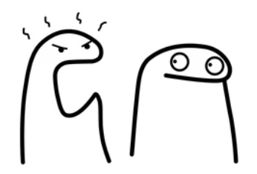
A Practical Daily Practice (10–15 minutes)
Part 3
Notice one recurring reaction
(trigger → thought → emotion → instinct / impulse).
Relabel: 'This is a thought/impulse.'
Breathe + refocus on a wholesome action.
Brief journal: what was the trigger? what did I choose?
End with prayer/meditation: reinforce the “will” into this new “inner reformed” direction.
Notes:
Block D (Slides 20–28): Integration + daily practice + closing & prompts

Slide 29
Discussion Prompts (for the group)
Reflect on habits, reactions, and practical steps for change.
Meditation?
Which wholesome spiritist concept works best in this situation?
Where do I notice 'automatic pilot' most in my daily life?
What helps me create a pause between impulse and action?
How can the group/community support repetition (without judgment)?
Notes:
Block D (Slides 20–28): Integration + daily practice + closing & prompts

Slide 30
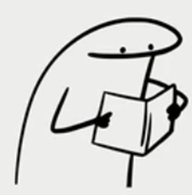
References – Spiritism
Kardec, A. The Spirits’ Book (O Livro dos Espíritos).
Kardec, A. The Gospel According to Spiritism
(O Evangelho Segundo o Espiritismo).
Kardec, A. The Mediums’ Book (O Livro dos Médiuns).

Slide 31
References – Norman Doidge
Doidge, N. (2007). The Brain That Changes Itself. New York:
Relevant chapters & key ideas used in this lecture (paraphrased):
• Ch. 1 – A Woman Perpetually Falling: the brain’s ability to change & sensory remapping.
• Ch. 3 – Redesigning the Brain: stroke recovery & constraint-induced therapy (“use it or lose it”).
• Ch. 4 – Acquiring Tastes and Loves: repetition shapes preferences and emotional responses.
• Ch. 5 – Midnight Resurrections: mental practice / guided imagery engaging brain pathways.
• Ch. 6 – Brain Lock Unlocked: OCD and the Four-Step Method (Relabel, Refocus, etc.)
Core concept: repeated attention and practice reshape neural pathways over time.

Slide 32
References – Eric R. Kandel
Kandel, E. R. (2006). In Search of Memory: The Emergence of a New Science of Mind. New York: W. W. Norton.
Kandel, E. R., Schwartz, J. H., & Jessell, T. M. (eds.). Principles of Neural Science (multiple editions).
Key research program (Aplysia / synaptic plasticity; paraphrased):
  Repetition can strengthen or weaken connections (learning).
  Long-term memory involves gene transcription and new protein synthesis.
  Stable memory corresponds to lasting synaptic/structural change in pathways.
Nobel Prize in Physiology or Medicine (2000): shared award recognizing molecular ways of learning and memory.
Core concept used here: Learning → gene expression → synaptic change → circuit change.

