Slide 1
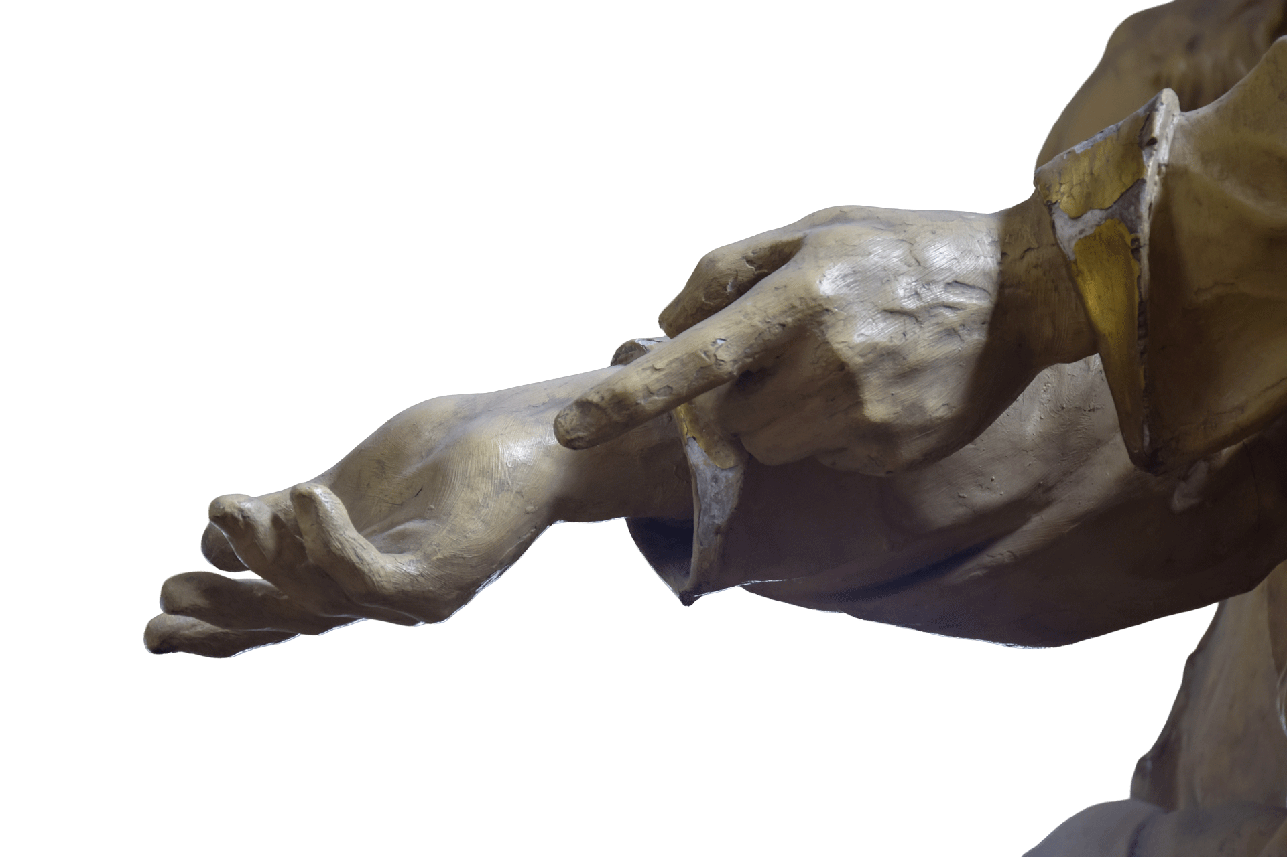
Saint Francis of Assisi
and Inner Reform
A Historical, Philosophical, Neuroscientific, and Spiritist Reading
30-Minute Presentation · Spiritist Society Towards the Light
Notes:
Open by clarifying: Francis is not a Spiritist thinker. He is a historical example of the moral transformation Spiritism calls reforma íntima. Invite the audience to read his life as a living drama of inner conversion.

Slide 2
The Central Question of Inner Reform
“What must change within us
so that the spirit may progress?”
Reforma Íntima is the gradual moral transformation of the spirit through self-knowledge, humility, charity, discipline, and alignment with divine law.
Francis of Assisi — a historical Christian figure — offers one of history's clearest living examples.
Notes:
Define reforma íntima as the gradual moral transformation of the spirit through self-knowledge, humility, discipline, charity, and alignment with divine law. Frame the whole talk around this one question.

Slide 3
Four Lenses, One Life
History
Philosophy
Neuroscience +
Spiritist Reflection
Actual events in Francis's life, verified by biographers (Bonaventure, Celano). Context: medieval Umbria, feudal honor, religious movements.
Questions of identity, self-knowledge, virtue, freedom. From Plato and Aristotle to modern ethics — the examined life.
How the brain changes through habit, suffering, compassion.
Spiritism: how the spirit advances through moral effort and love.
Notes:
Explain the interdisciplinary method briefly. These four lenses reinforce each other — none contradicts the others. Each enriches the Spiritist reading.

Slide 4
1. Youth in Assisi — The False Self
Spiritist & Philosophical Reading
Born ~1181, son of a prosperous cloth merchant
Fine clothes, festivities, admiration, dreams of knighthood
Life organized around recognition and social rank
Reward loops of approval, novelty, ambition reinforce identity
Pride, vanity, attachment to appearances
The egoic self: worth confused with status
Neuroscience: reward-seeking patterns dominate youth
Lesson: reform begins when illusion becomes visible
Notes:
Emphasize: sanctity does not begin in perfection. Francis started as an ordinary human being shaped by social prestige. Inner reform begins when illusion becomes visible.

Slide 5
2. War, Captivity & Illness — When Illusion Breaks
Spiritist & Philosophical Reading
Joined battle between Assisi and Perugia (~1202)
Taken prisoner; held for about a year
Released, then fell gravely ill — prolonged inner crisis
Ambition fails; old narrative collapses
Trials as occasions for awakening
Suffering breaks false narratives
Neuroscience: disruption opens space for new meaning
Lesson: reform often begins when life interrupts our illusions more forcefully than our conscience had managed to do
Notes:
Key insight: suffering does not cause sanctity, but it breaks the false certainty that prevents transformation. Spiritism reads trials as opportunities, not only punishments.

Slide 6
3. Slow Conversion — The Birth of Self-Examination
Spiritist & Philosophical Reading
Prayer deepens; silence increases
Old goals lose their charm — disorientation without new purpose
No sudden reversal; repeated effort, hesitation, clarity
He withdraws to pray in caves near Assisi
Inner reform is gradual — the spirit rarely destroys old habits in one moment
Self-examination is the beginning of ethics
Neuroscience: attention shifts from impulse to reflection
Lesson: inner reform is not a mood — it is a re-education of attention
Notes:
Critical point for a Spiritist audience: real transformation is progressive, not theatrical. This stage is the re-education of attention.

Slide 7
4. The Leper — The Decisive Turning Point
Spiritist & Philosophical Reading
Francis had always felt disgust and fear toward lepers
He forced himself to approach, assist — and embrace — one
He wrote later this was decisive in his conversion
Imitation of Christ: dignity where the world sees contamination
Charity conquers selfishness and pride
Love defeats the instinct of exclusion
Neuroscience: compassion training reshapes instinctive aversion
Lesson: inner reform becomes real when compassion defeats repulsion, fear, and pride
Notes:
This is perhaps the most powerful single episode for reforma íntima: not a change of opinion but a change of moral reflex. Pause here and let the audience feel the weight of it.

Slide 8
5 & 6. San Damiano and Renunciation
San Damiano -- Repair my house
Renunciation — The Radical Break
Francis prays before the crucifix. He first repairs ruined chapels — then understands the deeper call: rebuild the soul.
Spiritism: the first temple is the conscience. Symbols can reorient a life when meaning becomes emotionally vivid.
Francis publicly strips himself of paternal wealth and status, placing himself under God alone.
Detachment is moral freedom. Neuroscience: dismantling an old self-model requires a new organizing center. For Francis: the Gospel.
Notes:
Two events that belong together: hearing the call to rebuild, and then shedding the old identity. The external and internal are mirror images.Lesson from San Damiano: the world's repair begins in the repair of conscience. Lesson from renunciation: inner reform requires detachment not only from objects, but from the false self those objects sustain.

Slide 9
7 & 8. Brotherhood, Discipline, and Charity
Brotherhood
Rule of Life
Charity as Proof
Francis gathers companions. A fraternity forms organically around poverty, service, and prayer. Community as moral reinforcement.
Humility, simplicity, service, and prayer become daily practice — not occasional inspiration.
Virtue is formed by repetition (Aristotle). New habits stabilize new character (neuroscience).
Care for the poor, peacemaking, gentleness.
Spiritist principle: the measure of spiritual progress is charity — not words but conduct.
Notes:
Key Spiritist insight: good intentions alone do not transform the spirit. Habits do. And charity is the practical criterion of progress.Lesson: inner reform matures when aspiration becomes method. Inner reform is authenticated by outward charity.

Slide 10
9 & 10. Canticle of the Creatures and Greccio
Canticle of the Creatures
Greccio — Teaching Through Tenderness
Praise through Brother Sun, Sister Moon, water, fire, earth — and even Sister Death. Gratitude replaces control; communion replaces domination.
Spiritism: harmony with divine law. Neuroscience: awe reduces egocentric narrowing.
Lesson: inner reform expands the self from possession to participation.
Francis creates the first Christmas crèche — vivid, embodied, affective. Truth is not only explained but felt.
Spiritism: moral transformation requires touching feeling, not only the intellect. Neuroscience: emotion and imagery deepen moral memory.
Lesson: the heart is reformed by truth felt, not only truth understood.
Notes:
Two expressions of transformed consciousness — one poetic/cosmic, one pedagogical and tender.

Slide 11
11. Final Suffering — Love Tested in Pain
Spiritist & Philosophical Reading
Illness, physical decline, near-blindness
Disappointments within his own growing movement
The stigmata: deepest identification with Christ
Composed the Canticle while gravely ill — even singing of Sister Death
Transformation is proven under trial, not in comfort
Suffering reveals whether pride has truly diminished
Neuroscience: pain narrows and hardens — to remain loving is a profound conquest
Lesson: inner reform is confirmed when adversity no longer destroys charity
Notes:
Ask the audience: who are we when life no longer comforts us? This is where the depth of inner reform is proven.

Slide 12
12. The Complete Arc of Reforma Íntima
From
To
Vanity and pride
Desire for status and honor
Aversion and fear of the outcast
Attachment to wealth and image
Self-display and social identity
Egoic contraction
Humility and simplicity
Service and fraternal care
Compassion for the suffering
Radical detachment
Quiet, charitable presence
Cosmic fraternity and praise
→
Notes:
Pause here. Let the arc be visible. From is where we begin; To is what the spirit can become. Invite the audience to locate themselves somewhere on this arc.The spirit advances through lived transformation. Francis's life shows the near-perfect dramatic arc of reforma íntima. Inner reform is not repression of personality — it is purification of it.

Slide 13
Questions for Self-Examination
01
What false self am I still defending?
02
What suffering in my life may be inviting awakening?
03
Whom do I still reject or avoid inwardly — my own leper?
04
What attachment is blocking my moral progress?
05
Is my spirituality visible in charity — in concrete acts of love?
Notes:
Do not rush through these. Read them slowly. Invite a moment of silence. These are not rhetorical — they are meant to be carried home.Invite self-examination rather than admiration from a distance. The measure of tonight is whether the audience leaves with one concrete intention for inner reform.

Slide 14
"Inner reform is not sudden perfection.
It is the daily conversion of pride into humility,
of selfishness into charity,
and of suffering into spiritual growth."
Saint Francis of Assisi · c. 1181–1226 Assisi, Italy – 2026 San Francisco, USA
Spiritist Society Towards the Llight Presentation
Notes:
End slowly and meditatively. Consider a moment of silence before closing. Francis's life is not a model to admire from a distance — it is a mirror in which each spirit can recognize its own path.

